Slide 1
Apache Web Server

Slide 2
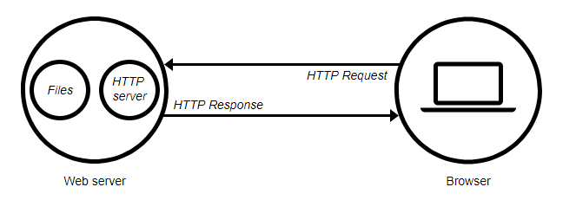
What is Web Server
A web server is a computer system that processes requests via HTTP, the basic network protocol used to distribute information on the World Wide Web.

Slide 3
What is Apache Web Server
The Apache HTTP server is the most widely-used web server in the world
It is free to download and install.
Port no used 80
By default location of web page is “DocumentRoot - /var/www/html “
DocumentRoot directive is the configuration where you can specify the folder location from where the static files will be served.

Slide 4
What is Apache SSL
Secure Socket Layer (SSL) port is 443
SSL is important to protect communication between browser and web-server
Requires the creation of SSL certificates and Certificate Signing Requests (CSR)
For integrity SSL certificates are signed by a Certificate Authority’s (CA) such as Verisign
Self signed Certificates will also work but your browser will not trust it and will give a warning to users (which most don’t read)

Slide 5
How Apache SSL Works
Each SSL certificate has a Public and Private key
The Public Key is used to encrypt the information
The Public Key is accessible to everyone
The private Key is used to decipher the information
The private should be not be disclosed

Slide 6
Role of Certificate Authority
There are a number of CA that certify certificates
Most browsers have pre-included public Keys from the CA’s
A CA certified certificate will have validation information signed by the CA’s private key
The browser will decrypt the validation information using the public key and verify that the certificate is certified by the CA

Slide 7
Apache Virtual Hosting
Apache Provides multiple options of virtual hosting and scales
Name Based virtual hosts
IP Based Virtual Hosts
Aliases
Its recommended to use an IP address over hostnames in virtual hosting configuration

Slide 8
Start Apache!
Start apache2 Service
# service apache2 start
# /etc/init.d/apache2 start
Check that you can access http://localhost in your browser
Check that you can access https://localhost in your browser, and that you get a certificate warning
Click on the padlock icon in your browser and check that the certificate details are correct.

Slide 9
